Slide 1
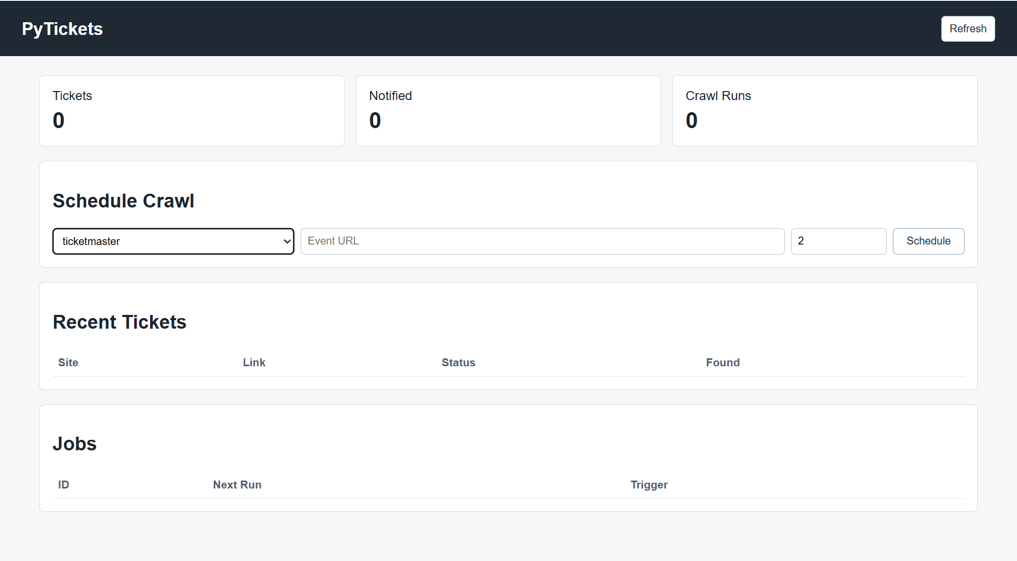
PyTickets
https://github.com/ksu-is/PyTickets.git
Multi-Site Ticket Scraper.
For Live Events from sports to concerts.
Use filters to select tickets within users' requirements (price, number, seat position, admission type, etc.)
Send link to all found tickets to users’ email, etc.
User decides whether he/she wants tickets and buys them (this part is on the user).
Team Members: Michael Arize

